Slide 1

CAPSTONE PROJECT - NORTHWIND TRADERS SALES ANALYSIS
MICROSOFT | POWER BI

Slide 2

PUBLICATIONS
Valuable insights :Our analysis indicates that Northwind Traders is a high-volume business where profitability is heavily dependent on logistical efficiency rather than just sales growth. The data suggests that while we have a strong, consistent demand for core product categories, our overall financial health is dictated by how effectively we manage the "cost-to-serve"—specifically by aligning our inventory levels and shipping strategies with the specific purchasing cycles of our top-tier customers.
Sales Trends & Seasonality: Our data indicates consistent revenue growth, but with sharp seasonal spikes. We've identified that specific product categories drive disproportionate revenue during peak months, suggesting our marketing and stock levels should be synchronized with these recurring cycles rather than maintained at a flat rate year-round.
Sales Analysis
Customer Concentration & Loyalty: We found that a small percentage of our customer base—the "Vital Few"—contributes to the majority of our total volume. Our analysis shows that retaining these high-value clients is significantly more cost-effective than acquisition, emphasizing a need for personalized loyalty strategies for our top-tier accounts.
Customer Analysis
Employee Impact & Sales Efficiency: Our analysis reveals a direct correlation between specific sales representatives and high-margin deals. However, we also noticed that higher sales volumes sometimes correlate with higher discount rates, indicating a need to shift employee KPIs from "Total Revenue" to "Gross Profit per Order."
Employee Analysis
Inventory & Fulfillment Optimization: The dataset highlights a gap between stock availability and order demand. We’ve identified "dead stock" in low-performing categories that ties up capital, while high-demand items occasionally face stockouts, suggesting that automating our reorder points based on historical lead times will immediately improve cash flow.
Geographic Profitability: While we are shipping globally, our analysis shows that shipping overhead to certain regions is disproportionately high. This indicates that we should either adjust our regional pricing tiers or consolidate shipments to protect our margins in distant markets.
Inventory Analysis

Slide 3
Objective : To engineer a comprehensive and centralized analytical ecosystem that synthesizes raw operational data into actionable strategic intelligence. Our objective is to eliminate data silos and provide stakeholders with a "single source of truth“
to evaluate Northwind Traders’ organizational health in real-time.
Analysis Scope : Our analysis delivers a multidimensional evaluation of the enterprise, performing a deep dive into Sales Dynamics (revenue velocity and margin health), Customer Intelligence (behavioral segmentation and retention patterns), Workforce Optimization (employee performance metrics and negotiation efficiency), and Supply Chain Logistics (inventory fluidity and global fulfillment costs).
Goal : To empower the organization with data-driven foresight, moving beyond retrospective reporting to proactive optimization. By identifying high-impact levers in our cost-to-serve and customer loyalty cycles, we aim to fortify Northwind’s competitive advantage and maximize long-term institutional profitability.

Slide 4
Insight & Recommendations: Northwind’s health depends on a high concentration of revenue from top-tier products and a few power customers, but inconsistent employee discounting often erodes total profit. To drive growth, we must shift focus from gross sales volume to net profitability by automating inventory reorders and launching a data-driven loyalty program to secure our most valuable accounts.
Report & Presentation: "This ecosystem synthesizes raw operational data into actionable intelligence. It provides leadership with a 'command center' to monitor Northwind’s health, identify hidden risks in the supply chain, and protect profit margins through data-driven employee and customer management."

Slide 5
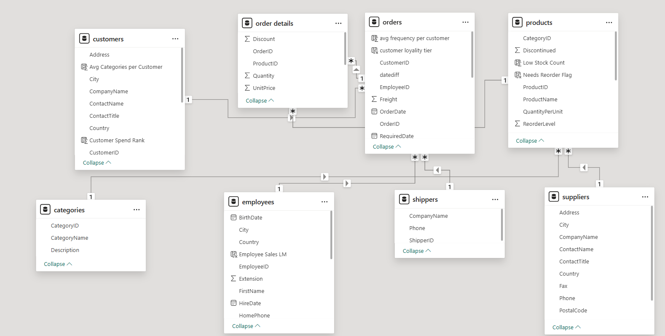
ER DIAGRAM

Slide 6

POWER BI PROBLEM STATEMENTS
MICROSOFT | POWER BI

Slide 7
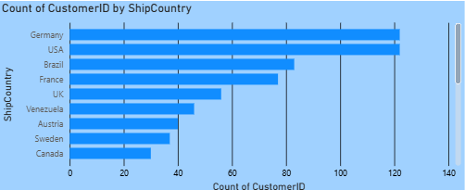
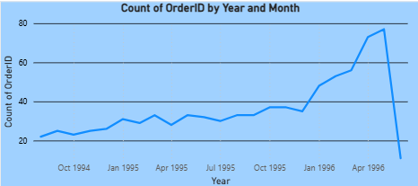
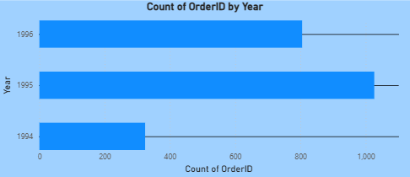
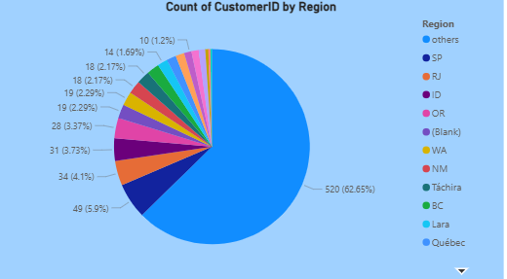
SALES AND TREND ANALYSIS

Slide 8
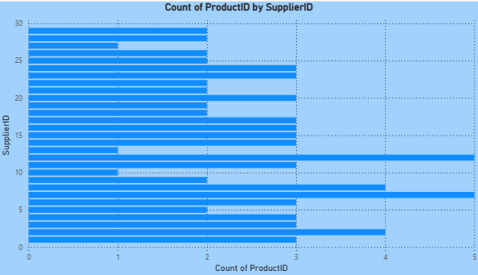
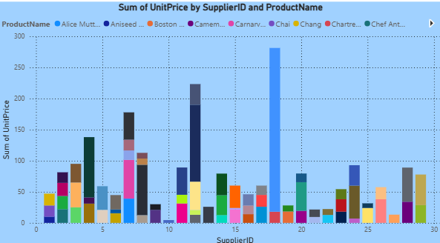
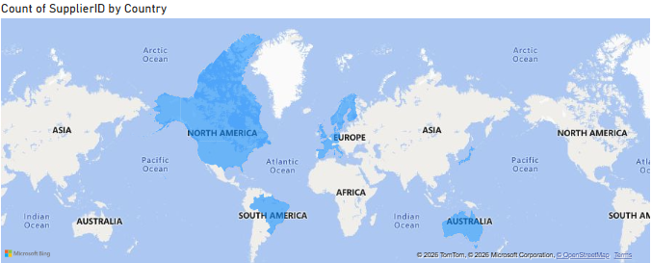
Supplier Analysis

